Slide 1
Machine Learning

Slide 2
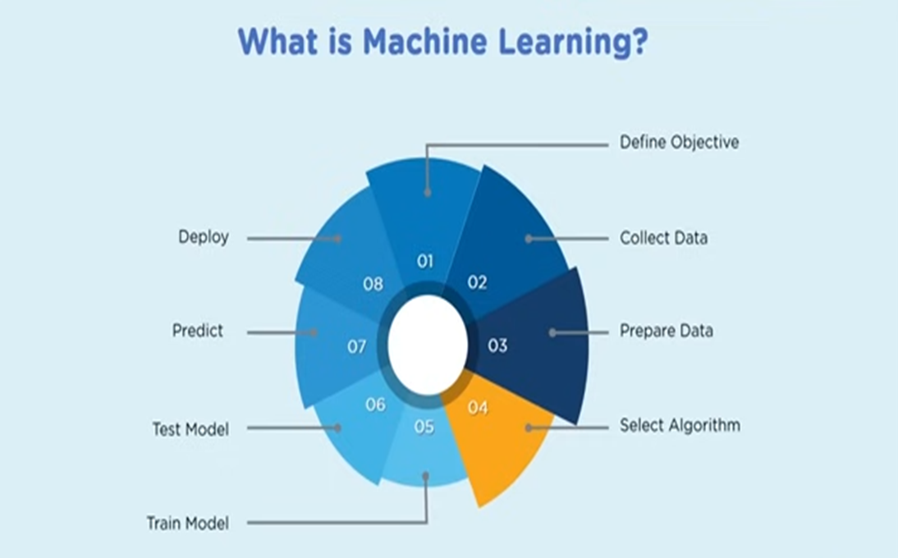

Slide 3
Types of Regression Techniques in ML
A regression problem is when the output variable is a real or continuous value, such as “salary” or “weight”. Many different models can be used, and the simplest is linear regression. It tries to fit data with the best hyperplane that goes through the points.
What is Regression Analysis?
Regression Analysis is a statistical process for estimating the relationships between dependent or criterion variables and one or more independent variables or predictors.
Regression analysis is generally used when dealing with a dataset with the target variable in the form of continuous data. Regression analysis explains the changes in criteria about changes in select predictors.
The conditional expectation of the requirements is based on predictors where the average value of the dependent variables is given when the independent variables are changed.
Three significant uses for regression analysis are determining the strength of predictors, forecasting an effect, and trend forecasting.

Slide 4
What is the purpose of using Regression Analysis?
There are times when we would like to analyze the effect of different independent features on the target or, what we say, dependent features.
This helps us make decisions that can affect the target variable in the desired direction.
Regression analysis is heavily based on statistics and hence gives quite reliable results; for this reason, only regression models are used to find the linear as well as non-linear relation between the independent and the dependent or target variables.

Slide 5
Types of Regression Techniques
There are several types of regression techniques, each suited to different kinds of data and relationships. The main types of regression techniques are:
1. Linear Regression
Polynomial Regression
Stepwise Regression
Decision Tree Regression
Random Forest Regression
Support Vector Regression
Ridge Regression
Lasso Regression
ElasticNet Regression
10. Bayesian Linear Regression

Slide 6
Linear Regression
Linear regression is used for predictive analysis. Linear regression is a linear approach for modeling the relationship between the criterion or the scalar response and the multiple predictors or explanatory variables. Linear regression focuses on the conditional probability distribution of the response given the values of the predictors. For linear regression, there is a danger of overfitting. The formula for linear regression is:
Syntax:
y = θ₀ + θ₁ x
where,
θ₁ – It is the model weights or parameters
θ₀ – It is known as the bias.
This is the most basic form of regression analysis and is used to model a linear relationship between a single dependent variable and one or more independent variables.
Here, a linear regression model is instantiated to fit a linear relationship between input features (X) and target values (y). This code is used for simple demonstration of the approach.

Slide 7
from sklearn.linear_model import LinearRegression
# Create a linear regression model
model = LinearRegression()
# Fit the model to the data
model.fit(X, y)
# Predict the response for a new data point
y_pred = model.predict(X_new)
Note: This code demonstrates the basic workflow of creating, training, and utilizing a linear regression model for predictive modeling tasks.

Slide 8
Polynomial Regression
This extension of linear regression is used to model a non-linear relationship between the dependent variable and independent variables. The syntax remains the same, but now, in the input variables, we include some polynomial or higher degree terms for some already existing features. Linear regression was only able to fit a linear model to the data at hand. However, with polynomial features, we can easily fit some non-linear relationships between the target and input features.
Here is the code for a simple demonstration of the Polynomial regression approach.

Slide 9
from sklearn.linear_model import PolynomialRegression
# Create a polynomial regression model
model = PolynomialRegression(degree=2)
# Fit the model to the data
model.fit(X, y)
# Predict the response for a new data point
y_pred = model.predict(X_new)
Note: This code demonstrates the basic workflow of creating, training, and utilizing a Polynomial regression model for predictive modeling tasks.

Slide 10
Linear regression with one variable

Slide 11
Assumptions of Linear Regression:
There must be a linear relationship between independent and dependent variables.
There should not be any outliers present.
No heteroscedasticity
Sample observations should be independent.
Error terms should be normally distributed with a mean of 0 and constant variance.
Absence of multicollinearity and autocorrelation.

Slide 12
1. L - Linearity
Assumption: The relationship between the independent variables (X) and the dependent variable (Y) is linear.
What it means: The change in the dependent variable due to a one-unit change in an independent variable is constant. The model should be specified as Y = β₀ + β₁X₁ + ... + βₖXₖ + ε, not a non-linear form (e.g., Y = β₀ + β₁X₁² + ε).
What happens if it’s violated? The model will systematically misrepresent the relationship, leading to biased and unreliable predictions. When a straight line is unfit, you might see a clear pattern (e.g., a curve) in the residual plot.

Slide 13
2. I - Independence of Errors
Assumption: The error terms (residuals) are uncorrelated with each other.
What it means: The error for one observation (data point) does not influence the error for another. This is most commonly violated in time-series data (where today’s error might be correlated with yesterday’s error) or spatial data.
What happens if it’s violated? Standard errors of the coefficient estimates become underestimated, leading to inflated t-statistics and a higher risk of Type I errors (falsely rejecting a true null hypothesis, i.e., finding a significant effect where none exists).

Slide 14
3. N - Normality of Errors
Assumption: The error terms are normally distributed.
What it means: For any fixed value of X, the values of Y are normally distributed around the regression line. This assumption is crucial for conducting hypothesis tests and constructing coefficient confidence intervals.
What happens if it’s violated? With large sample sizes (thanks to the Central Limit Theorem), the estimates of the coefficients themselves are still unbiased. However, p-values and confidence intervals become unreliable for small sample sizes.

Slide 15
4. E - Equal Variance (Homoscedasticity)
Assumption: The error terms have a constant variance across all levels of the independent variables.
What it means: The “spread” or “scatter” of the residuals should be roughly the same for all predicted values of Y. This is the opposite of heteroscedasticity (changing variance).
What happens if it’s violated? Similar to the independence assumption, the standard errors become biased and inefficient. This makes confidence intervals and hypothesis tests untrustworthy.
Coefficients can have counter-intuitive signs (e.g., a negative coefficient for a variable that should clearly have a positive effect).

Slide 16
5. No (or little) Perfect Multicollinearity
Assumption: The independent variables are not perfectly correlated with each other.
What it means: You should not be able to perfectly predict one independent variable using another. A high degree of correlation (even if not perfect) can also be problematic.
What happens if it’s violated? It becomes difficult to isolate the individual effect of each correlated variable on the dependent variable. This leads to:
High standard errors and unstable coefficient estimates (small changes in the data can cause large changes in the coefficients).
Coefficients can have counter-intuitive signs (e.g., a negative coefficient for a variable that should clearly have a positive effect).

Slide 17
Sustainability Tests (Diagnostic Tests)
1. Testing Linearity
Visual Test: Residual vs. Fitted Plot
How: Plot the model’s residuals (on the y-axis) against the predicted (fitted) values (on the x-axis).
What to look for: The points should be randomly scattered around zero with no discernible pattern (e.g., no U-shape or curve). A clear pattern indicates non-linearity.
Statistical Test: Ramsey’s RESET Test
How: It tests whether non-linear combinations of the fitted values help explain the dependent variable. A significant p-value suggests a non-linear relationship is missing from the model.

Slide 18
2. Testing Independence of Errors
Statistical Test: Durbin-Watson Test
How: This is the standard test for autocorrelation in time-series data. The test statistic ranges from 0 to 4.
What to look for: A value close to 2 indicates no autocorrelation. A value toward 0 indicates positive autocorrelation, and a value toward 4 indicates negative autocorrelation.

Slide 19
3. Testing Normality of Errors
Visual Test: Q-Q Plot (Quantile-Quantile Plot)
How: Plot the quantiles of your standardized residuals against the quantiles of a theoretical normal distribution.
What to look for: The points should closely follow the 45-degree reference line. Deviations from this line indicate departures from normality.
Statistical Tests:
Shapiro-Wilk Test: A formal test of normality. A non-significant p-value (p > 0.05) suggests the residuals are normally distributed.
Kolmogorov-Smirnov Test: Another test for normality.
Note: These tests are often too sensitive with large sample sizes, so the Q-Q plot is often more informative.

Slide 20
4. Testing Homoscedasticity (Equal Variance)
Visual Test: Scale-Location Plot (or Residual vs. Fitted Plot)
How: This is similar to the residual vs. fitted plot. It plots the square root of the standardized residuals against the fitted values.
What to look for: A horizontal line with randomly spread points indicates constant variance. A fanning pattern (cone shape) indicates heteroscedasticity (variance increases/decreases with fitted values).
Statistical Tests:
Breusch-Pagan Test: A common test where a significant p-value (p < 0.05) indicates the presence of heteroscedasticity.
White Test: A more general test that is also sensitive to non-linearities.

Slide 21
5. Testing for Multicollinearity
Diagnostic: Variance Inflation Factor (VIF)
How: VIF measures how much the variance of a coefficient is inflated due to multicollinearity. It is calculated for each independent variable.
What to look for:
VIF = 1: No correlation.
1 < VIF < 5: Moderate correlation (usually acceptable).
VIF >= 5 to 10: High correlation, a cause for concern.
Simple Check: Correlation Matrix
How: Look at the pairwise correlations between independent variables.
What to look for: Correlations above |0.7| or |0.8| can signal a potential multicollinearity problem.

Slide 22
Assumption | Visual Test | Statistical Test | What to Look For
Linearity | Residual vs. Fitted Plot | Ramsey’s RESET | No pattern in plot; p > 0.05
Independence | - | Durbin-Watson | Statistic ~ 2 (1.5 - 2.5 is often ok)
Normality | Q-Q Plot | Shapiro-Wilk, KS | Points on line; p > 0.05
Equal Variance | Scale-Location Plot | Breusch-Pagan | Horizontal line; p > 0.05
No Multicollinearity | - | VIF | VIF < 5 (or 10)

Slide 23
Housing Prices
Price
Size (feet²)
Supervised Learning
Given the “right answer” for each example in the data.
Regression Problem
Predict real-valued output

Slide 24
Training set of
housing prices
Size in feet² (x) | Price (Rs) in 1000's (y)
2104 | 460
1416 | 232
1534 | 315
852 | 178
… | …
Notation:
m = Number of training examples
x’s = “input” variable / features
y’s = “output” variable / “target” variable

Slide 25
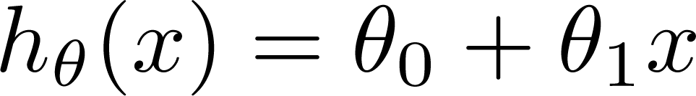
Training Set
How do we represent h ?
Learning Algorithm
x
x
y
x
x
x
x
x
Size of house
h
Estimated price
x
hypothesis
x
Linear regression with one variable.
Univariate linear regression.
h maps from x’s to y’s

Slide 26

Training Set
Size in feet² (x) | Price
2104 | 460
1416 | 232
1534 | 315
852 | 178
… | …
Hypothesis:
‘s: Parameters
How to choose ‘s ?

Slide 27
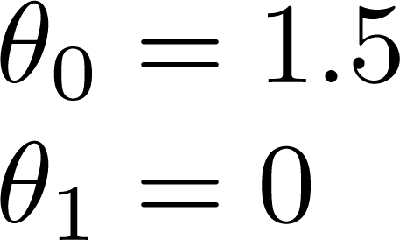
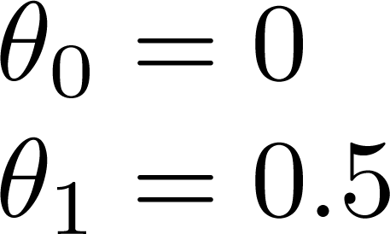
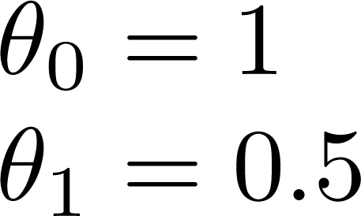

Slide 28
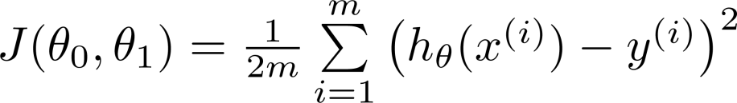
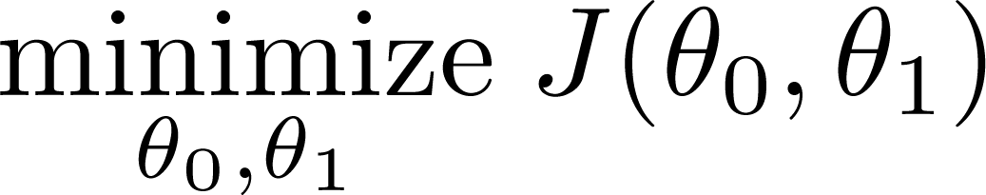
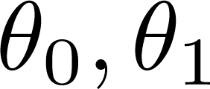


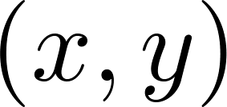
y
x
Idea: Choose so that is close to for our training examples
Squared Error function

Slide 29
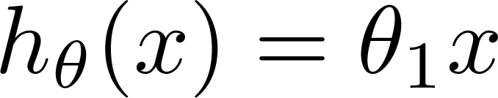

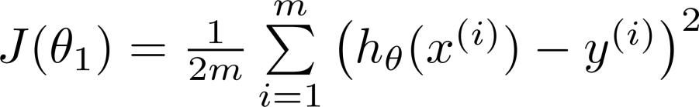
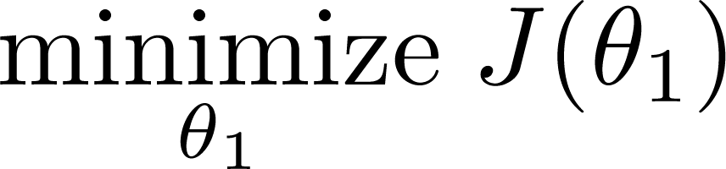
Simplified
Hypothesis:
ϴ₀ = 0
Parameters:
Cost Function:
Goal:

Slide 30






(for fixed , this is a function of x)
(function of the parameter )
y
x
Calculate J(0), J(0.5), J(1.0)

Slide 31

(for fixed , this is a function of x)
(function of the parameter )
y
x

Slide 32

(for fixed , this is a function of x)
(function of the parameter )
y
x

Slide 33
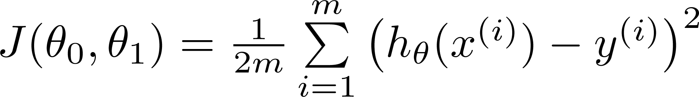
Hypothesis:
Parameters:
Cost Function:
Goal:

Slide 34
1. Mean Squared Error (MSE)large differences.
2. Mean Absolute Error (MAE)
3. Cross-Entropy Loss (Log Loss)
4. Hinge Loss
5. Huber Loss
6. Kullback-Leibler Divergence (KL Divergence)

Slide 35
Choosing the Right Cost Function
Choosing the correct cost function depends on the type of machine learning task, the data, and the specific characteristics of the problem. Here are some guidelines:
Regression Tasks: Mean Squared Error (MSE), Mean Absolute Error (MAE), and Huber Loss are common choices. MSE is preferred when we want to penalize larger errors more, while MAE is robust to outliers. Huber Loss offers a balance between the two.
Classification Tasks: Cross-Entropy Loss is commonly used in classification problems, especially when probabilities are involved. Hinge Loss is used in support vector machines. For imbalanced datasets, specialized cost functions like focal loss (a variant of cross-entropy) are used.
Probabilistic Models: Kullback-Leibler Divergence is used when comparing probability distributions, particularly in models like Variational Autoencoders.

Slide 36
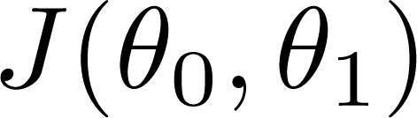


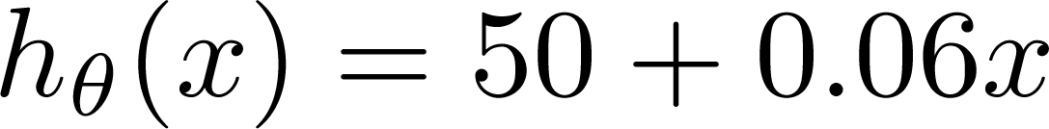
(for fixed , this is a function of x)
(function of the parameters )
Price ($)
in 1000’s
Size in feet² (x)

Slide 37
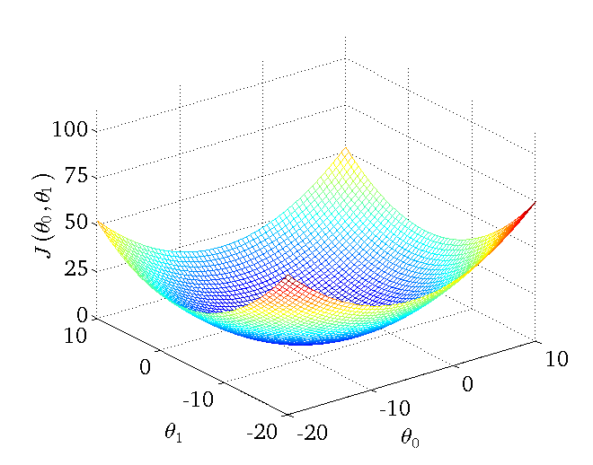

Slide 38
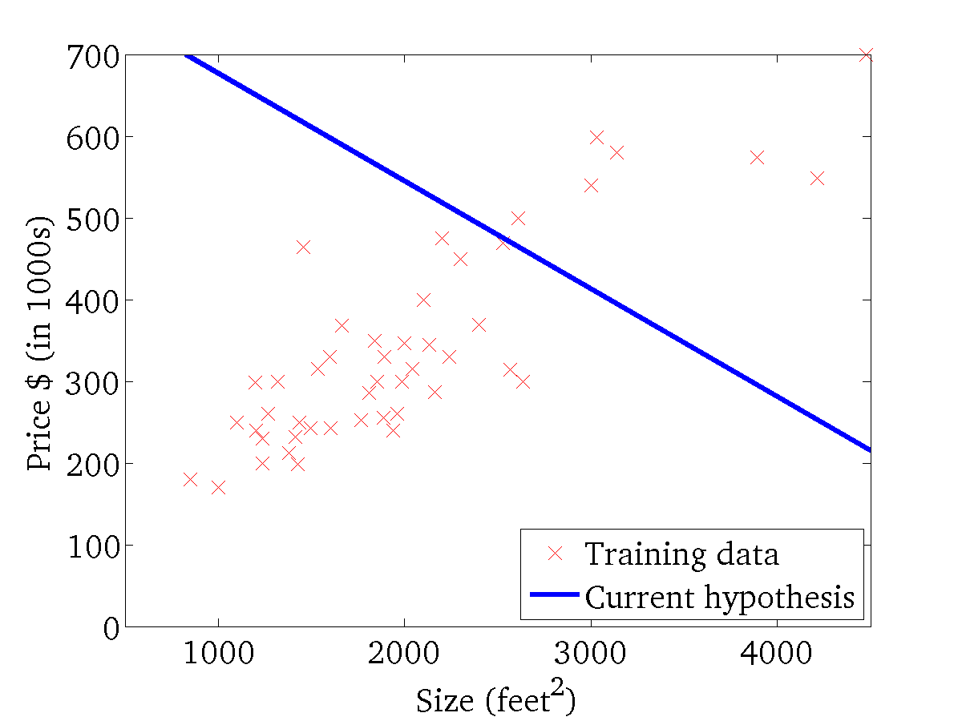
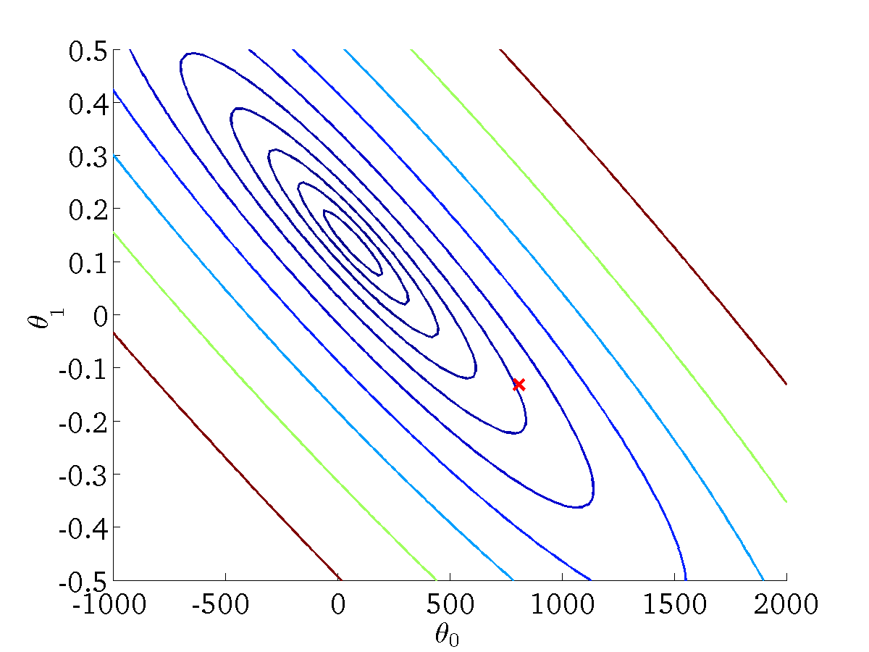
(for fixed , this is a function of x)
(function of the parameters )

Slide 39
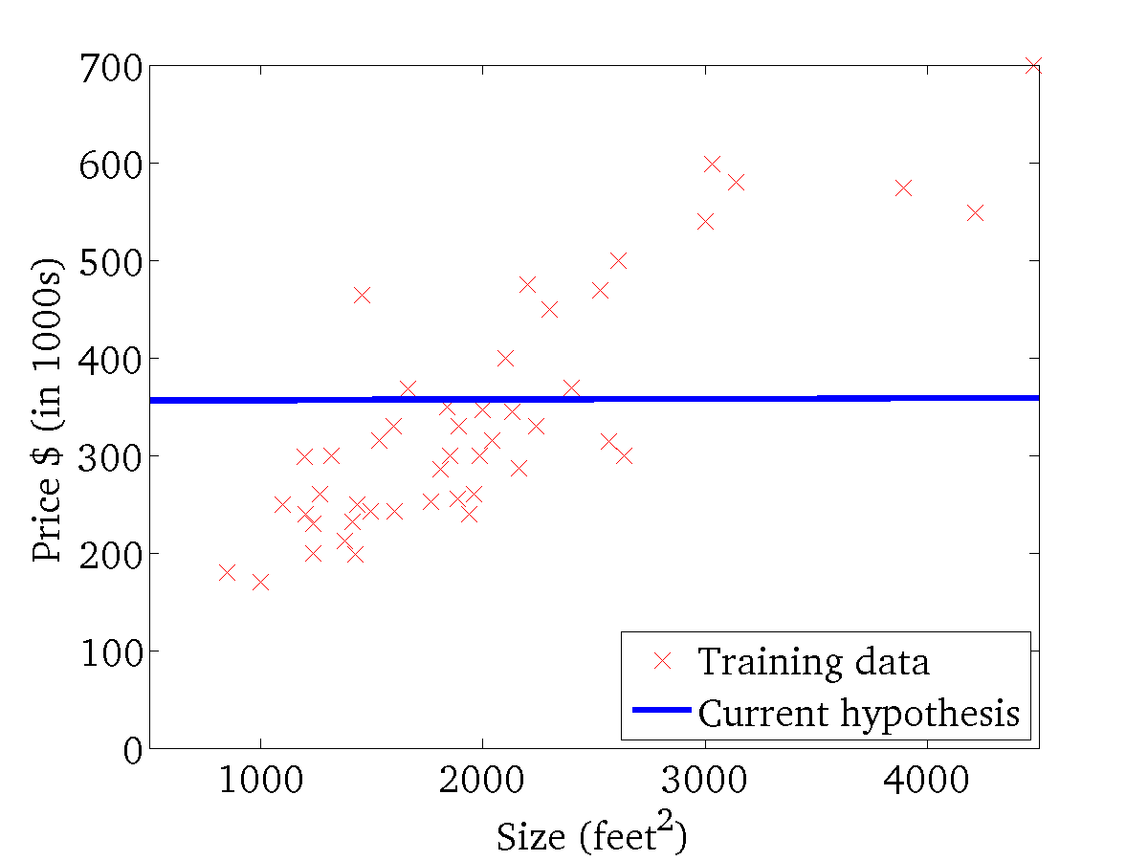
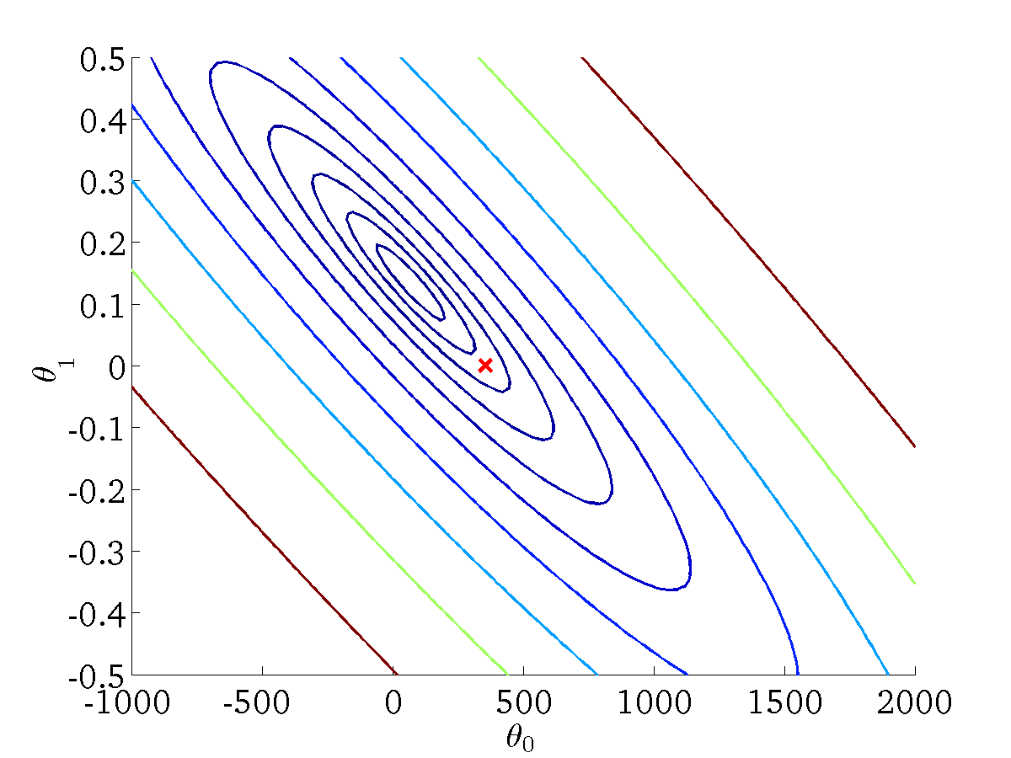
(for fixed , this is a function of x)
(function of the parameters )

Slide 40
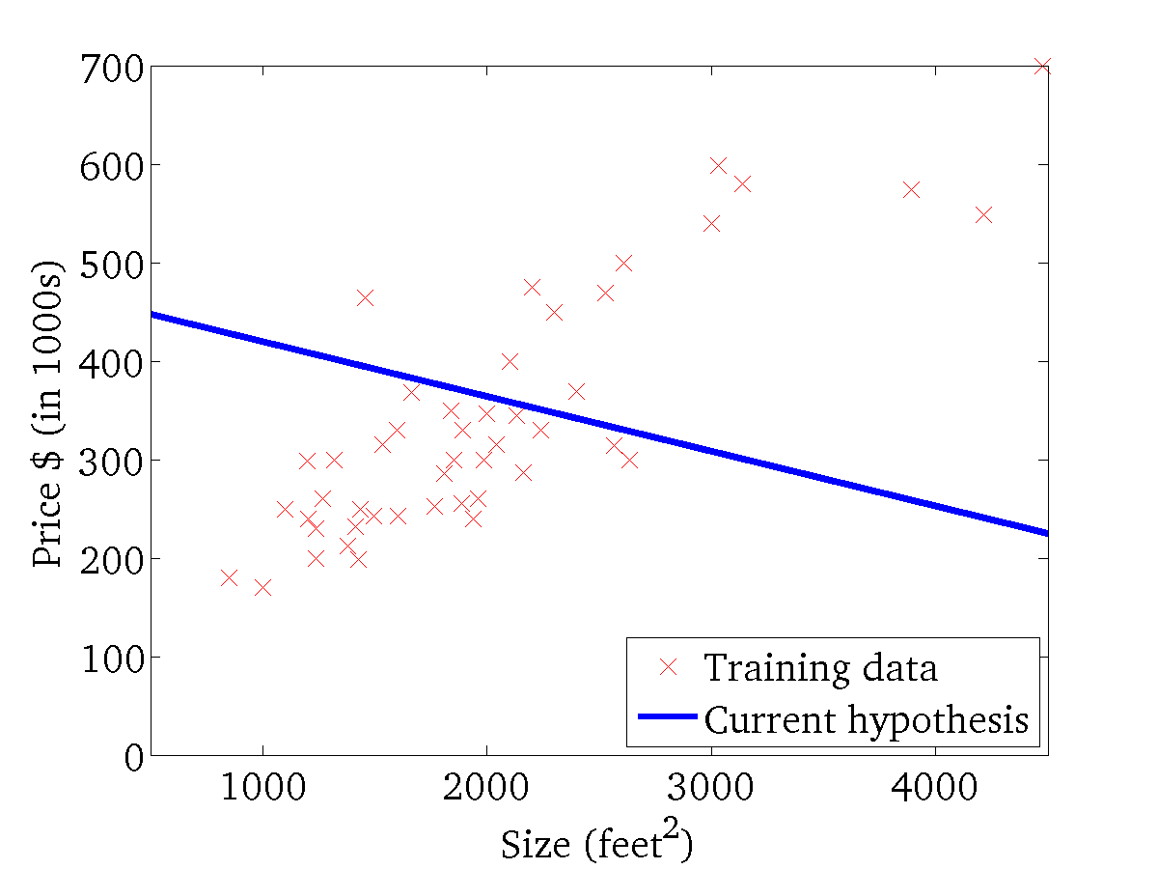

(for fixed , this is a function of x)
(function of the parameters )

Slide 41
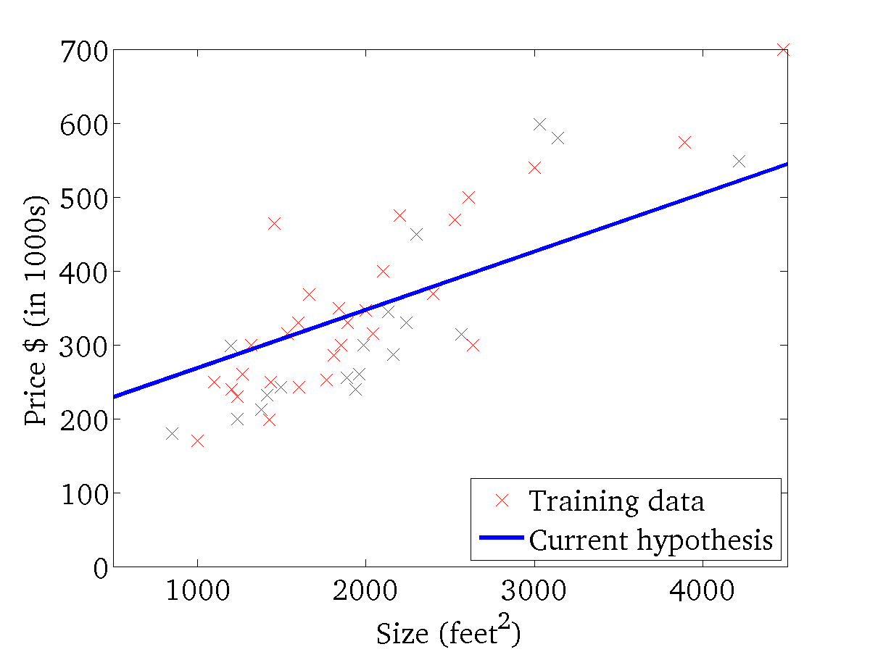
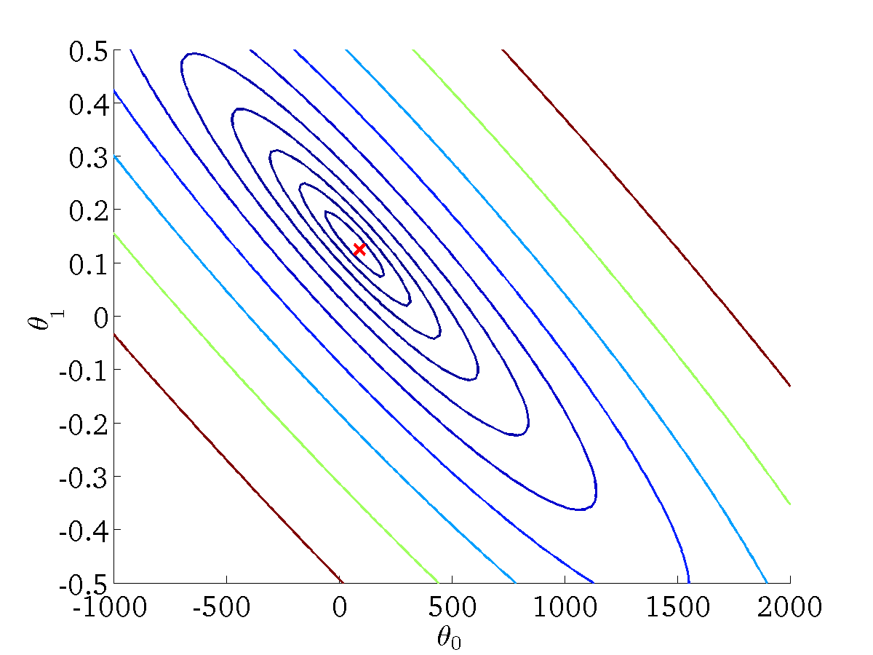
(for fixed , this is a function of x)
(function of the parameters )

Slide 42
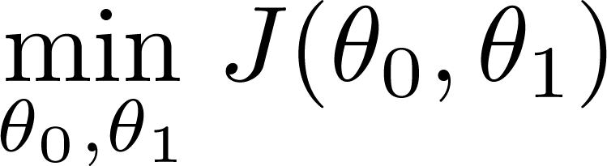
Have some function
Want
Outline:
Start with some
Keep changing to reduce until we hopefully end up at a minimum

Slide 43
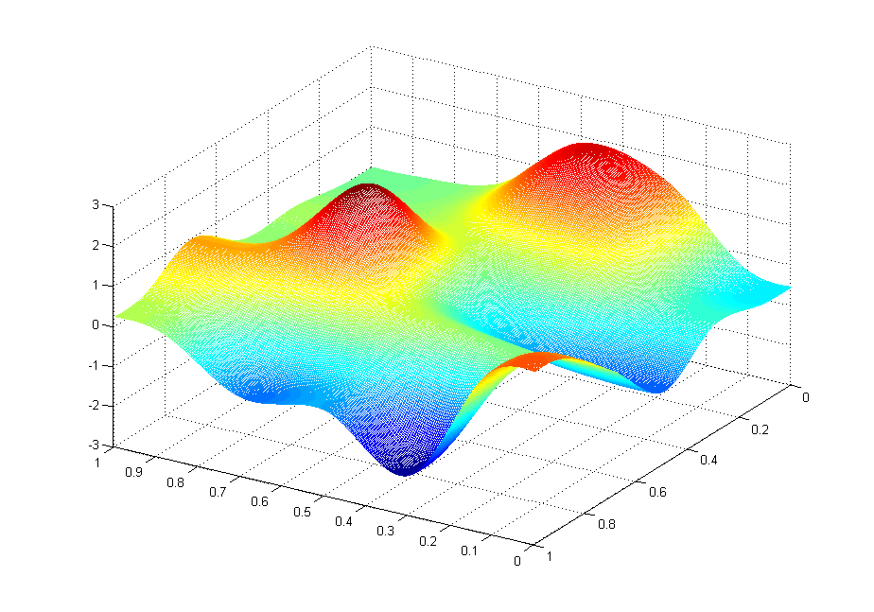
J(θ₀,θ₁)
θ₁
θ₀

Slide 44
J(θ₀,θ₁)
θ₁
θ₀

Slide 45
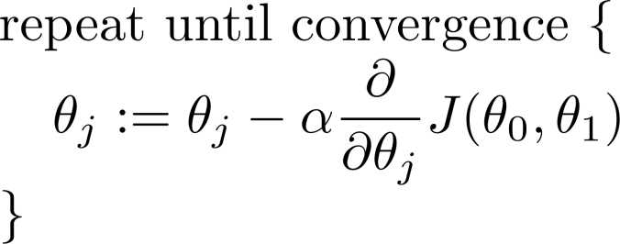
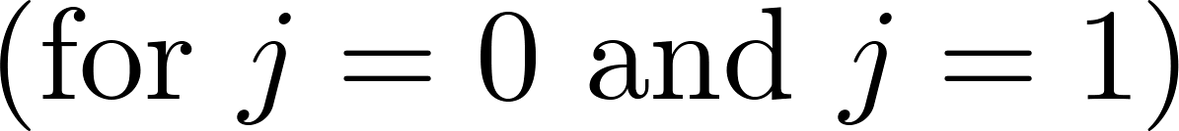
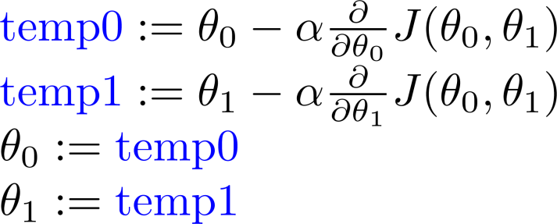
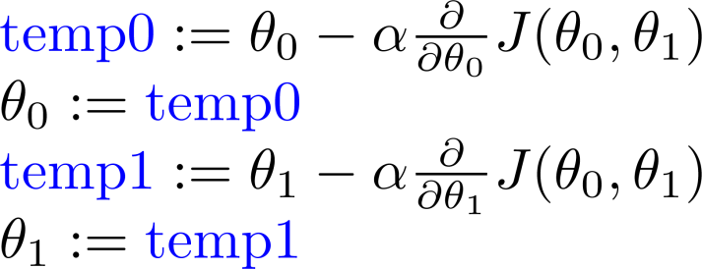
Gradient descent algorithm
Correct: Simultaneous update
Incorrect:

Slide 46
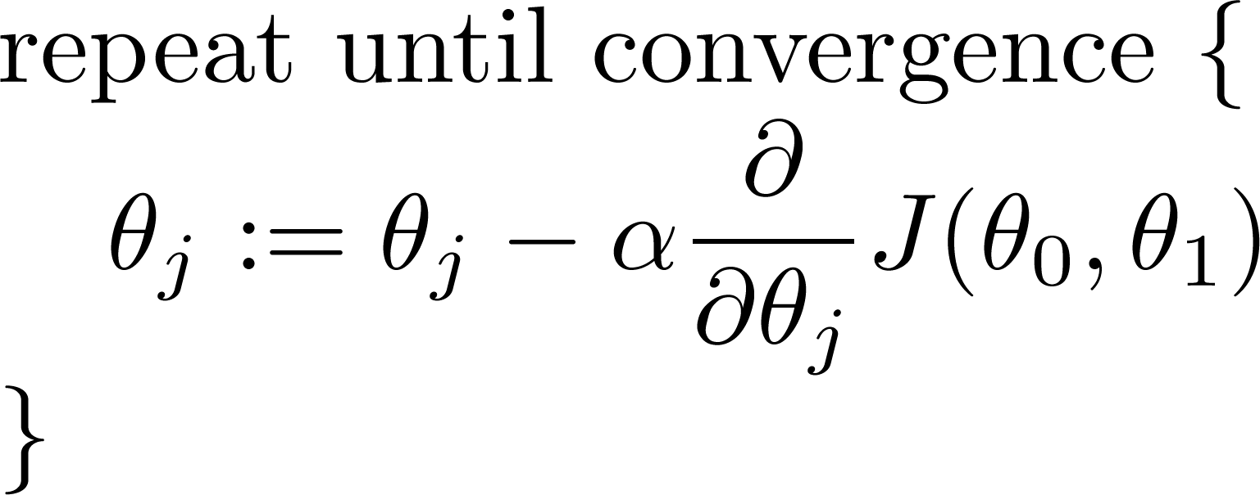
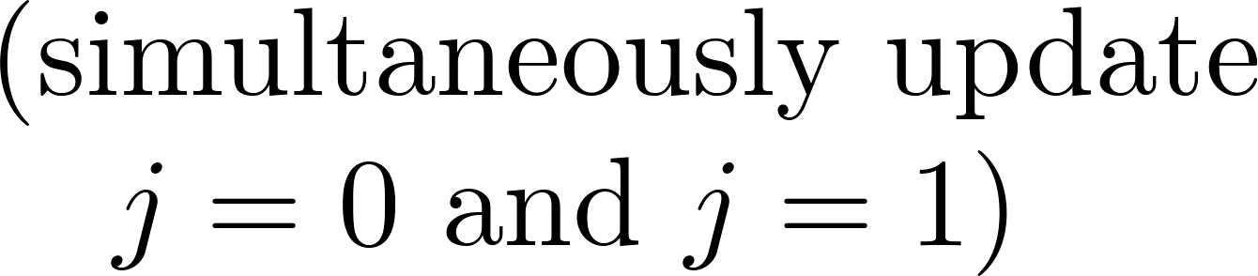
Gradient descent algorithm

Slide 47
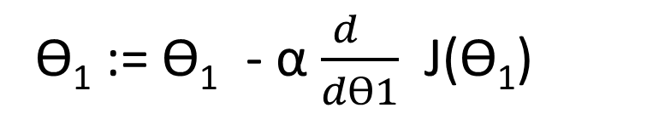
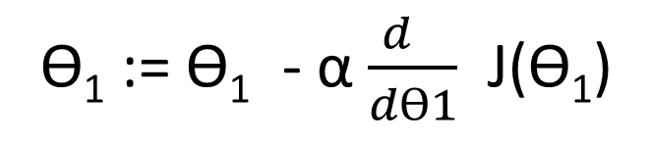
J(ϴ₁)
ϴ₁ := ϴ₁ - α $\frac{d }{dϴ1}$ J(ϴ₁)
X
ϴ₁ := ϴ₁ - α (positive number)
J(ϴ₁)
ϴ₁ := ϴ₁ - α $\frac{d }{dϴ1}$ J(ϴ₁)
X
ϴ₁ := ϴ₁ - α (negative number)

Slide 48
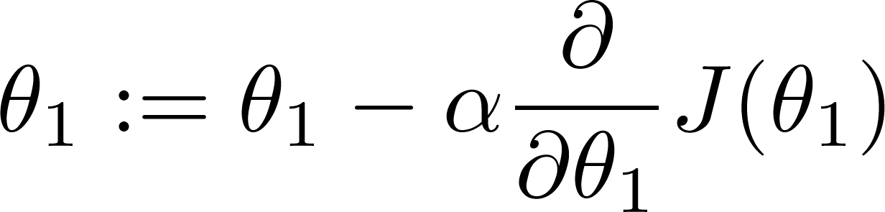
x
x
x
x
If α is too small, gradient descent can be slow.
x
x
x
If α is too large, gradient descent can overshoot the minimum. It may fail to converge, or even diverge.
x
x
x
x

Slide 49

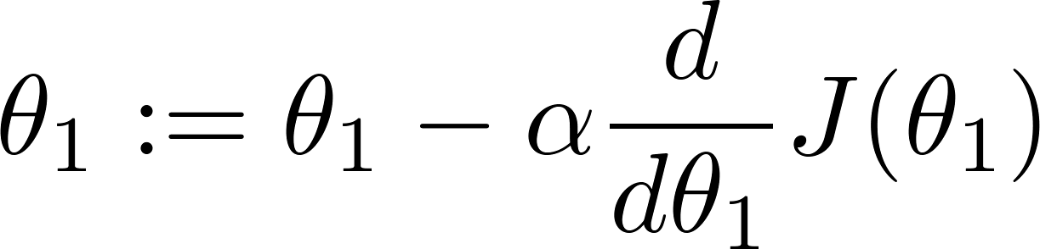
at local optima
Current value of

Slide 50
Gradient descent can converge to a local minimum, even with the learning rate α fixed.
As we approach a local minimum, gradient descent will automatically take smaller steps. So, no need to decrease α over time.

Slide 51
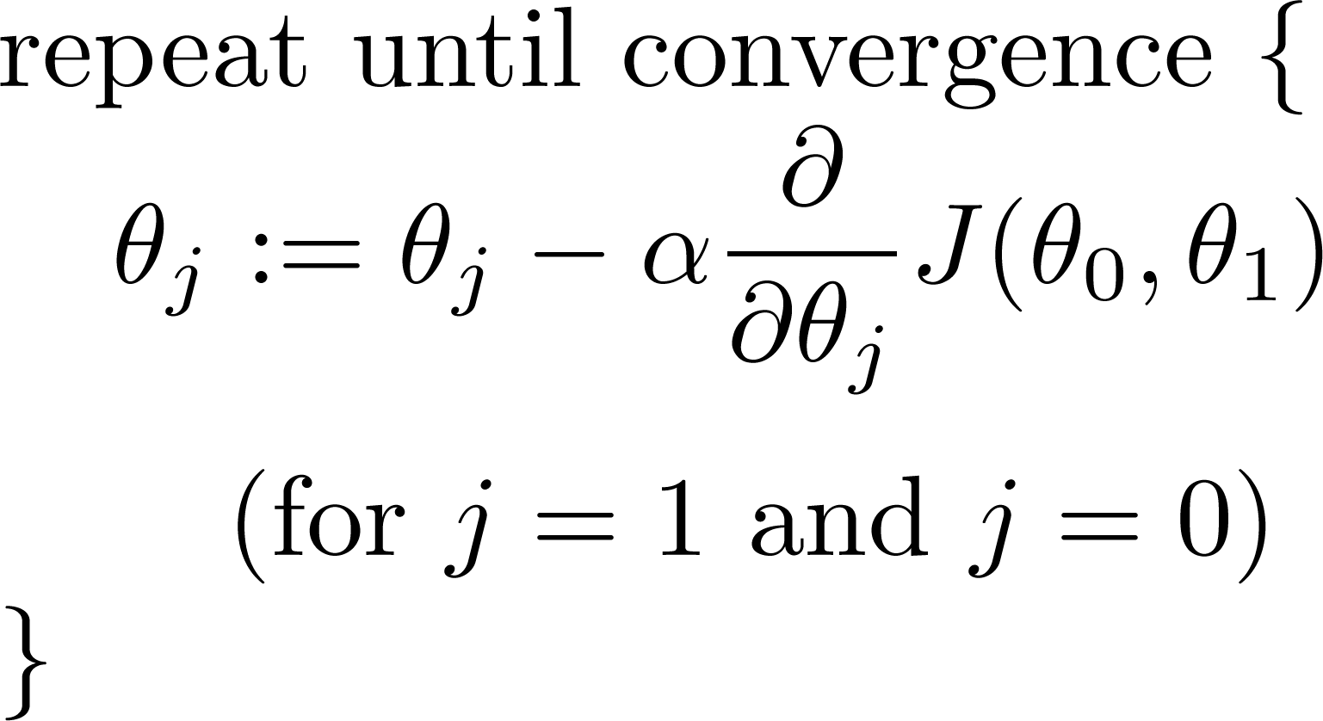
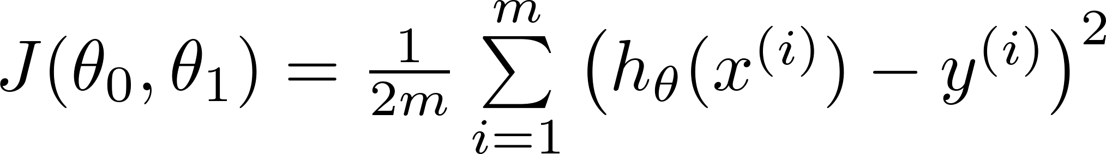
Gradient descent algorithm
Linear Regression Model

Slide 52
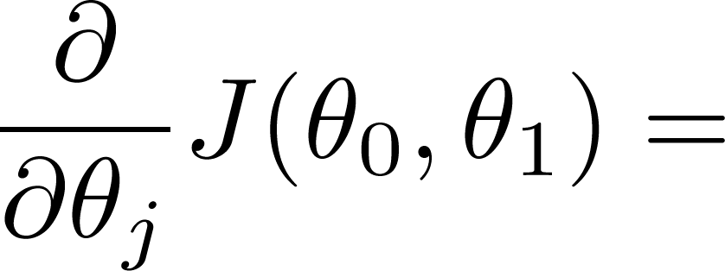
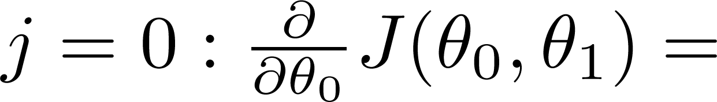
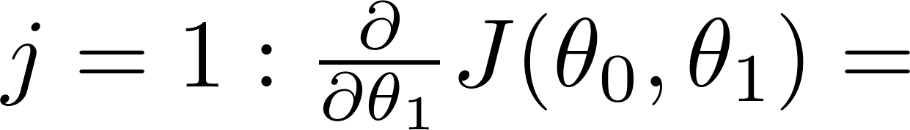

Slide 53
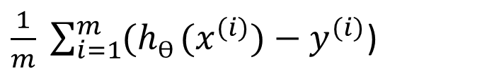
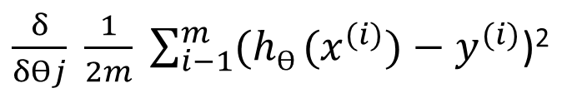
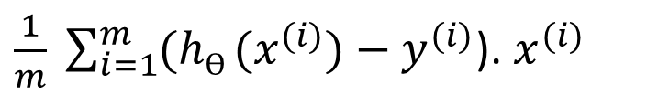
$\frac{δ}{δϴj} \frac{1}{2m} \sum_{i−1}^{m}{(hϴ {(x}^{(i)}{)−y}^{(i)}}$)²
$\frac{1}{m} \sum_{i=1}^{m}{(hϴ {(x}^{(i)}{)−y}^{(i)}}$)
$\frac{1}{m} \sum_{i=1}^{m}{(hϴ {(x}^{(i)}{)−y}^{(i)}}$). $x^{(i)}$

Slide 54
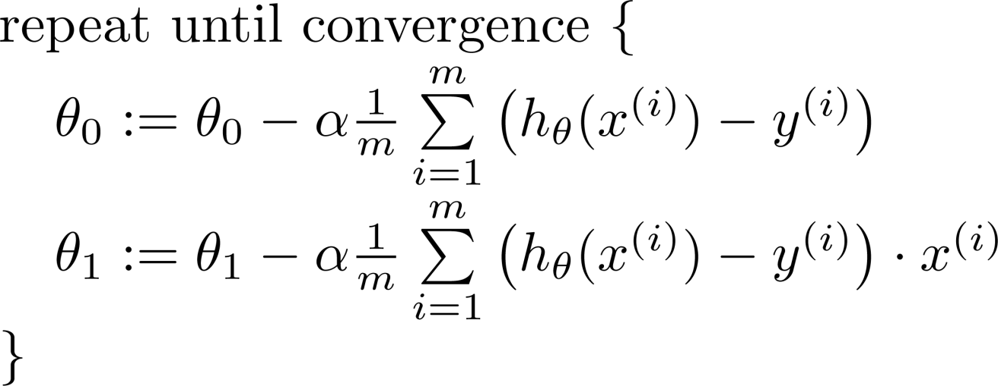

Gradient descent algorithm
update
and
simultaneously

Slide 55
“Batch” Gradient Descent
“Batch”: Each step of gradient descent uses all the training examples.

Slide 56
Meaning of Sustainability in ML/DL Models
1. Technical Sustainability
A model is sustainable if it remains valid and reliable over time even when:
Data distribution changes (concept drift, data drift).
New environments or domains are introduced (generalizability).
Requires continuous monitoring, retraining, explainability, and reproducibility.
Example: A fraud detection model must adapt to new fraud patterns to stay useful.

Slide 57
2. Environmental Sustainability
Training large DL models consumes enormous energy and compute resources.
Sustainable ML means optimizing energy use, using efficient architectures (e.g., pruning, quantization, TinyML), and considering the carbon footprint of training/inference.
Example: GPT-3 training required thousands of GPU-hours → sustainability calls for greener AI practices.

Slide 58
3. Economic & Operational Sustainability
A model is sustainable if it is cost-effective to deploy, maintain, and scale.
Includes:
Efficient inference for real-time applications.
Cloud vs. edge deployment trade-offs.
Automation of retraining pipelines (MLOps).

Slide 59
4. Ethical & Social Sustainability
Models must be fair, transparent, explainable, and unbiased.
A sustainable ML/DL model:
Avoids discrimination.
Respects privacy (e.g., differential privacy, federated learning).
Supports long-term societal benefit.

